Slide 1


Department of Collegiate and Technical Education
ELECTRONICS & COMMUNICATION
AUTOMATION & ROBOTICS-20EC53I ( V SEMESTER)
WEEK –3: Application of Sensors and Actuators in Automation and Robotics
DAY 3: MORNING SESSION
Electronics & Communication – 20EC53I

Slide 2
CONTENTS
What is Process Automation?
Demonstrate a case study on Process automation.
List all the sensors and give its specifications for the above case study
Practice: Build a circuit using Arduino on the above listed sensors for each given application and verify its working
Electronics and Communication Engineering 20EC53I

Slide 3
What is Process Automation?
Process automation means making manual processes automatic by way of technology using data and systems integration.
Process automation is an important step for business management as it can increase competitiveness, efficiency, and value for clients
Process automation uses technology to automate complex business processes.
It typically has three functions: automating processes, centralizing information, and reducing the requirement for input from people.
It is designed to remove bottlenecks, reduce errors and loss of data, all while increasing transparency, communication across departments, and speed of processing.
Electronics and Communication Engineering 20EC53I

Slide 4
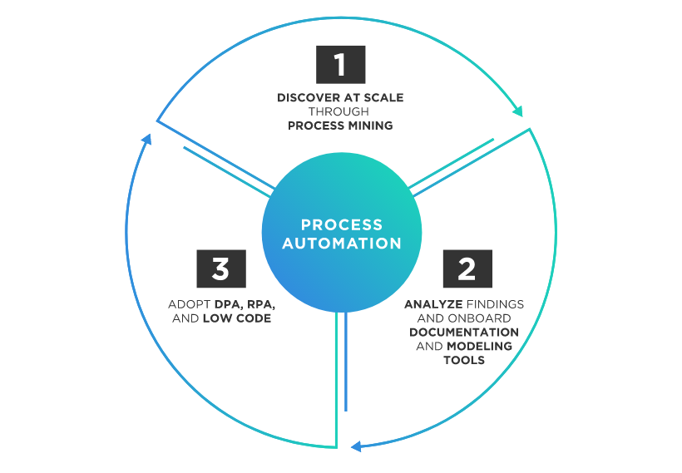
What is Process Automation?
Electronics and Communication Engineering 20EC53I

Slide 5
Process Automation Examples
Accounting and finance processes.
Appointment scheduling and rescheduling.
Contracts and consent forms.
Data gathering, analysis and risk assessment.
Document management.
Email marketing and social media.
Event RSVPs.
Financial aid and grant applications
HR enrollment and new hire onboarding.
Order processing and fulfillment.
Patient intakes and referrals.
Performance management.
Purchase orders and requisitions.
Recruitment.
Student enrollment and registration.
Time off requests.
Time or attendance tracking.
Travel requests.
Electronics and Communication Engineering 20EC53I

Slide 6
BENEFITS OF PROCESS AUTOMATION
Reducing costs—when businesses consolidate tasks, they have to perform fewer steps, which can reduce the amount of money they spend on all combined steps.
Increasing productivity—when businesses automate manual processes, they give their employees more time to perform other important tasks. More total work is accomplished.
Ensuring high availability—particularly in technology, automation can make services more available to users.
Increasing reliability—automation is a way to avoid human error. Computers can often find solutions more rapidly and reliably than can people.
Optimizing performance—the brief overview of historical automation above demonstrates how drastically automation changes job performance. Automation can shift a task from being time-consuming to ordinary or even obsolete.
Electronics and Communication Engineering 20EC53I

Slide 7
Demonstrate a case study on Process automation
Think about a car wash. The process, which is fully automated, looks something like this:
The customer chooses which wash type they want
System requests payment from the customer
Takes payment from the customer
Approves transaction and advises customer to drive into the carwash
Identifies when the car is in the right position using a sensor and advises the driver to stop
Uses a range of sensors to identify the car’s height and size
Runs the pre-selected and paid program. This includes a number of variables, including rinsing, washing with soap and brushes, wax application and blow-drying the car
When complete, advises the customer to exit the carwash.
Electronics and Communication Engineering 20EC53I

Slide 8
Demonstrate a case study on Process automation
While a very simple automation, this process is one that most people are familiar with, and seamlessly integrates a digital transaction and input from the customer and turns it into a mechanical series of automations using software, hardware, and communication to an accounting system.
Process automation streamlines a system by removing human inputs, which decreases errors, increases speed of delivery, boosts quality, minimizes costs, and simplifies the business process.
It incorporates software tools, people, and processes to create a completely automated workflow.
Electronics and Communication Engineering 20EC53I

Slide 9
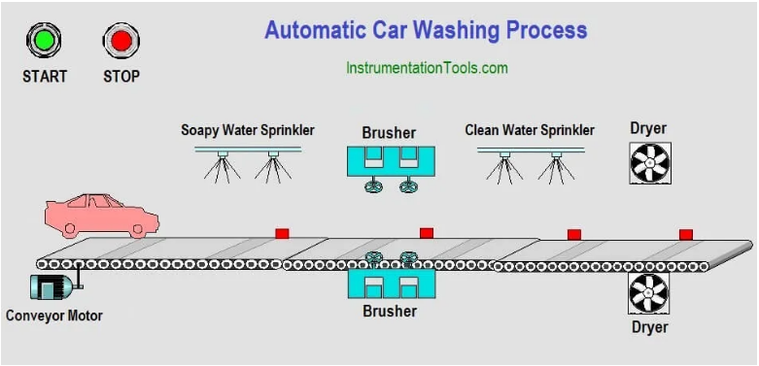
Automatic Car Washing
Electronics and Communication Engineering 20EC53I

Slide 10
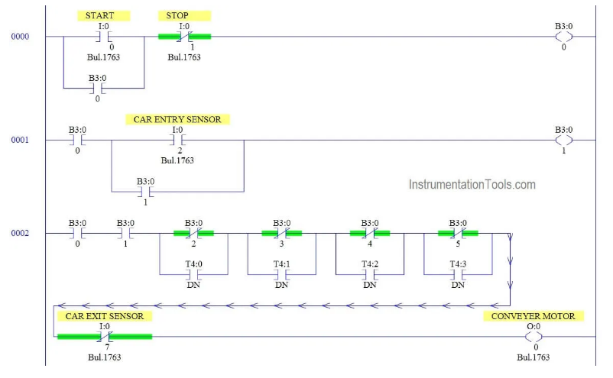
Car Washing PLC Ladder Logic
Electronics and Communication Engineering 20EC53I

Slide 11
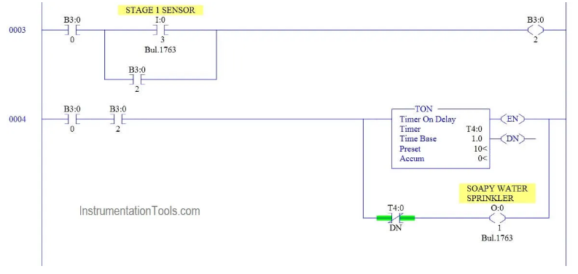
Car Washing PLC Ladder Logic
Electronics and Communication Engineering 20EC53I

Slide 12
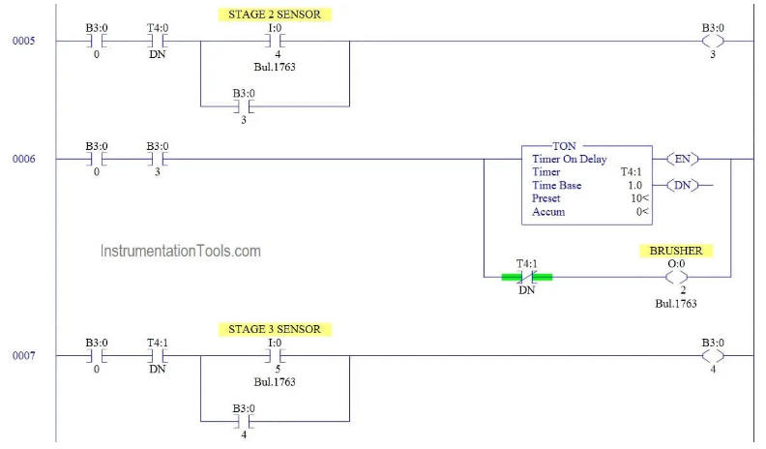
Car Washing PLC Ladder Logic
Electronics and Communication Engineering 20EC53I

Slide 13
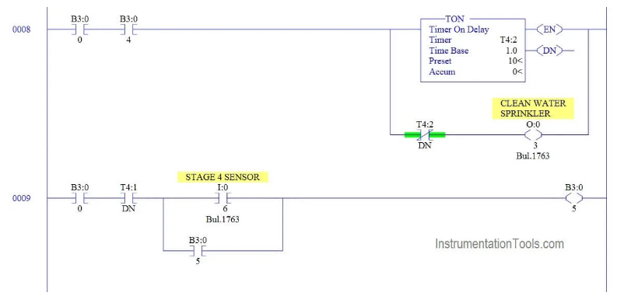
Car Washing PLC Ladder Logic
Electronics and Communication Engineering 20EC53I

Slide 14
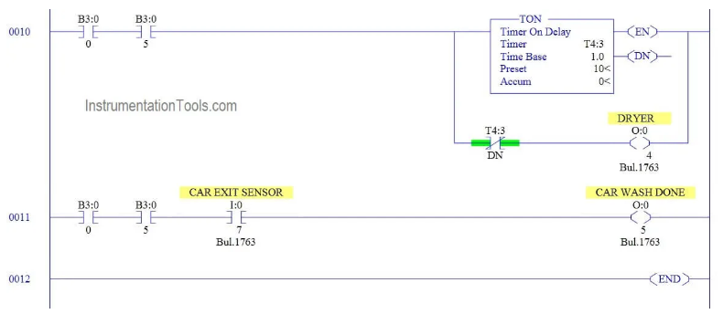
Car Washing PLC Ladder Logic

Slide 15
Program Description
The ladder logic of Automatic Car Washing Process using PLC Ladder Diagram explanation as follows :
RUNG 0000
Latching rung to operate the system through Master Start and Stop PB.
RUNG 0001
Car entry sensor triggers the memory bit which will turn on conveyor motor
RUNG 0002
ON/OFF operation of conveyor motor is happening in this rung using various conditions like Sensor input and timer done output.
Electronics and Communication Engineering 20EC53I

Slide 16
Program Description
Rung 0003 & 0004
When car reached stage 1 sensor conveyor motor should stop and water sprinkler should ON for 10 sec.
At the end of water sprinkler timer, Conveyor will again ON because of the parallel contact in rung 0002.
Rung 0004 & 0005
When car reached stage 2 sensor conveyor motor should stop and brusher should ON for 10 sec.
At the end of brushing process, Conveyor will again ON because of the parallel contact in rung 0002.
Electronics and Communication Engineering 20EC53I

Slide 17
Program Description
Rung 0007 & 0008
When car reached stage 3 sensor conveyor motor should stop and water sprinkler should ON for 10 sec.
At the end of water sprinkler timer, Conveyor will again ON because of the parallel contact in rung 0002.
Rung 0009 & 0010
When car reached stage 4 sensor conveyor motor should stop and water sprinkler should ON for 10 sec.
At the end of water sprinkler timer, Conveyor will again ON because of the parallel contact in rung 0002.
Rung 0011
When car reached exit ,car exit sensor will trigger the car wash done indication lamp(O:0/7)
Electronics and Communication Engineering 20EC53I

Slide 18
Problem Solution
Car entry sensor triggers the process and turns conveyor belt ON to move the car.
Soapy water sprinkler turns ON when stage 1 sensor detects the car and do the process for certain time.
Brusher turns ON when stage 2 sensors detects the car and do the process for certain time.
Clean water sprinkler turns ON when stage 3 sensors detects the car and do the process for certain time.
Dryer turns ON when stage 4 sensors detects the car and do the process for certain time.
Car exit sensor triggers conveyor motor to turn off.
Electronics and Communication Engineering 20EC53I

Slide 19
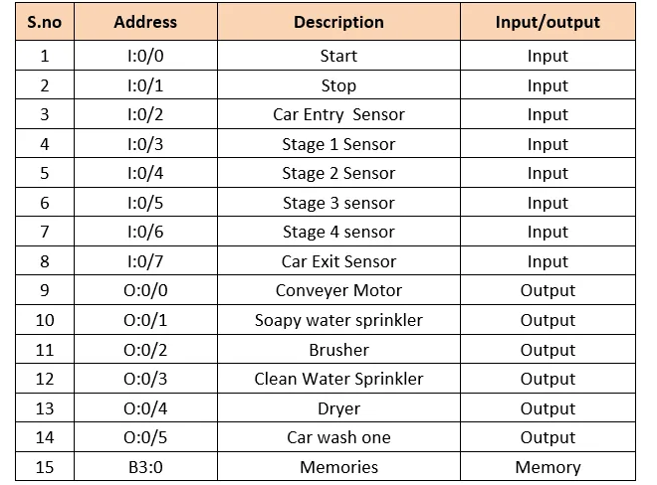
List of Inputs and Outputs
Electronics and Communication Engineering 20EC53I

Slide 20
List all the sensors and give its specifications for the above case study
Infrared sensor:
An infrared sensor is an electronic device, that emits in order to sense some aspects of the surroundings. An IR sensor can measure the heat of an object as well as detects the motion. These types of sensors measure only infrared radiation, rather than emitting it that is called a passive IR sensor. Usually, in the infrared spectrum, all the objects radiate some form of thermal radiation.
Electronics and Communication Engineering 20EC53I

Slide 21
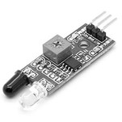
List all the sensors and give its specifications for the above case study
These types of radiations are invisible to our eyes, which can be detected by an infrared sensor. The emitter is simply an IR LED (Light Emitting Diode) and the detector is simply an IR photodiode that is sensitive to IR light of the same wavelength as that emitted by the IR LED. When IR light falls on the photodiode, the resistances and the output voltages will change in proportion to the magnitude of the IR light received.
LM 393
Electronics and Communication Engineering 20EC53I

Slide 22
Contd….
The LM393 series are dual independent precision voltage comparators capable of single or split supply operation.
These devices are designed to permit a common mode range–to–ground level with single supply operation. Input offset voltage specifications as low as 2.0 mV make this device an excellent selection for many applications in consumer automotive, and industrial electronics.
Electronics and Communication Engineering 20EC53I

Slide 23
Contd….
• Wide Single–Supply Range: 2.0 Vdc to 36 Vdc • Split–Supply Range: ±1.0 Vdc to ±18 Vdc • Very Low Current Drain Independent of Supply Voltage: 0.4 mA • Low Input Bias Current: 25 nA • Low Input Offset Current: 5.0 nA • Low Input Offset Voltage: 2.0 mV (max) LM393A 5.0 mV (max) LM293/393 • Input Common Mode Range to Ground Level
Electronics and Communication Engineering 20EC53I

Slide 24
Contd….
• Differential Input Voltage Range Equal to Power Supply Voltage • Output Voltage Compatible with DTL, ECL, TTL, MOS, and CMOS Logic Levels • ESD Clamps on the Inputs Increase the Ruggedness of the Device without Affecting Performance
Electronics and Communication Engineering 20EC53I

Slide 25
Practice Session
Build a circuit using Arduino on the SOUND sensor for security application and verify its working
Block diagram:
Sound sensor
Arduino UNO
Power supply
Buzzer
Electronics and Communication Engineering 20EC53I

Slide 26
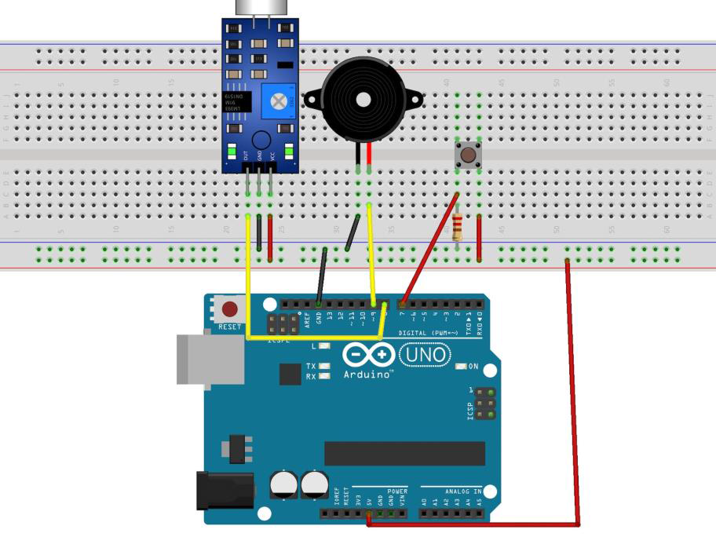
Contd….
Circuit Diagram
Electronics and Communication Engineering 20EC53I

Slide 27
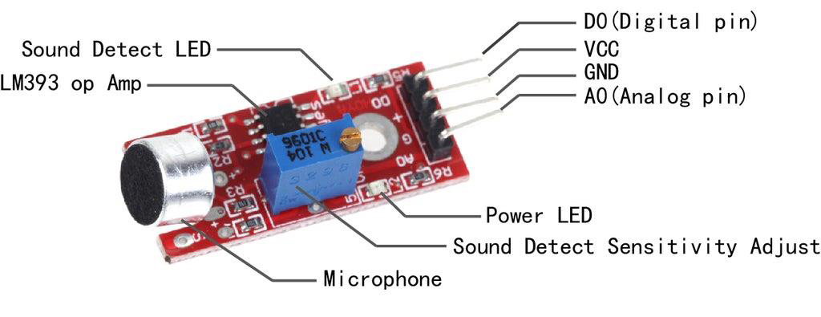
Contd….
Sound sensor
Electronics and Communication Engineering 20EC53I

Slide 28
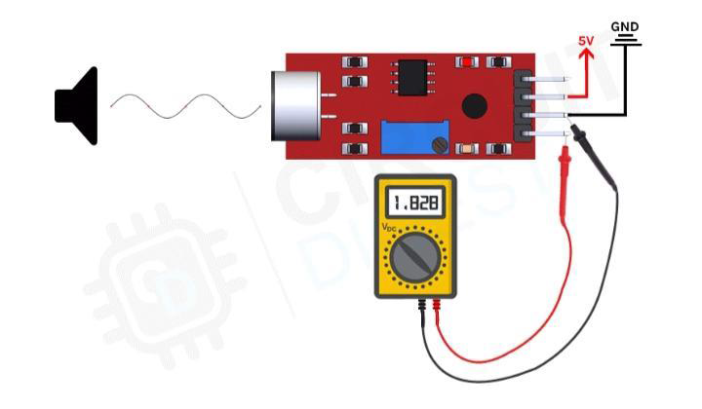
Contd….
The working of the sounds sensor module is very simple and easy to understand, the main component in this module is a condenser microphone. The microphone gives out only analog signals when a sound wave hits the diaphragm of the sensor, this analog signal gets processed by the op-amp and we get the digital output.
Working
Electronics and Communication Engineering 20EC53I

Slide 29
Contd….
Code
Arduino code for security alaram using sound sensor:-
Int soundSensor=2;
Int BUZZER=4;
Boolean BUZZERStatus=false;
Void setup() {
pinMode(soundSensor,INPUT);
pinMode(BUZZER,OUTPUT);
}
Void loop() {
Int SensorData=digitalRead(soundSensor);
If(SensorData==1){
If(BUZZERStatus==false){
BUZZERStatus=true;
digitalWrite(BUZZER,HIGH);
}
Else{
BUZZERStatus=false;
digitalWrite(BUZZER,LOW);
}
}
}
Electronics and Communication Engineering 20EC53I

Slide 30

Thank You
SMITHA SHENOY | Sel.Gr.Lecturer | Moderator | 111, GPT, CHANNAPATNA
VIJAYALAKSHMI PATIL | Sel.Gr.Lecturer | Subject Expert | 142 GWPT RAMANAGARA
HARINI R | Lecturer | Content Developer | 112 GPT TUMKUR
SUJATHA A | Lecturer | Content Developer | 112 GPT TUMKUR
GEETHA | Lecturer | Content Developer | 112 GWPT HASAN
Electronics and Communication Engineering 15EC43T

